Slide 1



SPEAKEZ
AI Language Translator
Kaali Lovell | Pavan Polireddy | Rakesh Tirumala
Steve St Fleur | Tanvi Prakash Gavali | Venkat Sai Pallapu

Slide 2

AGENDA
1- Sprint 0 Recap | 2- Project Overview | 3- Backlogs | 4- Team Metrics | 5- Product
Team Roles & Responsibilities Improvements Project Description Team Working Agreement Personas | MVP Languages & Tools Algorithms Diagrams | User Stories Acceptance Criteria Sprint 1 Stories Test Cases Story Completion | Team Velocity Burndown Charts Retrospective | Sprint 2 Stories Application Screenshots API Live Application Demo

Slide 3
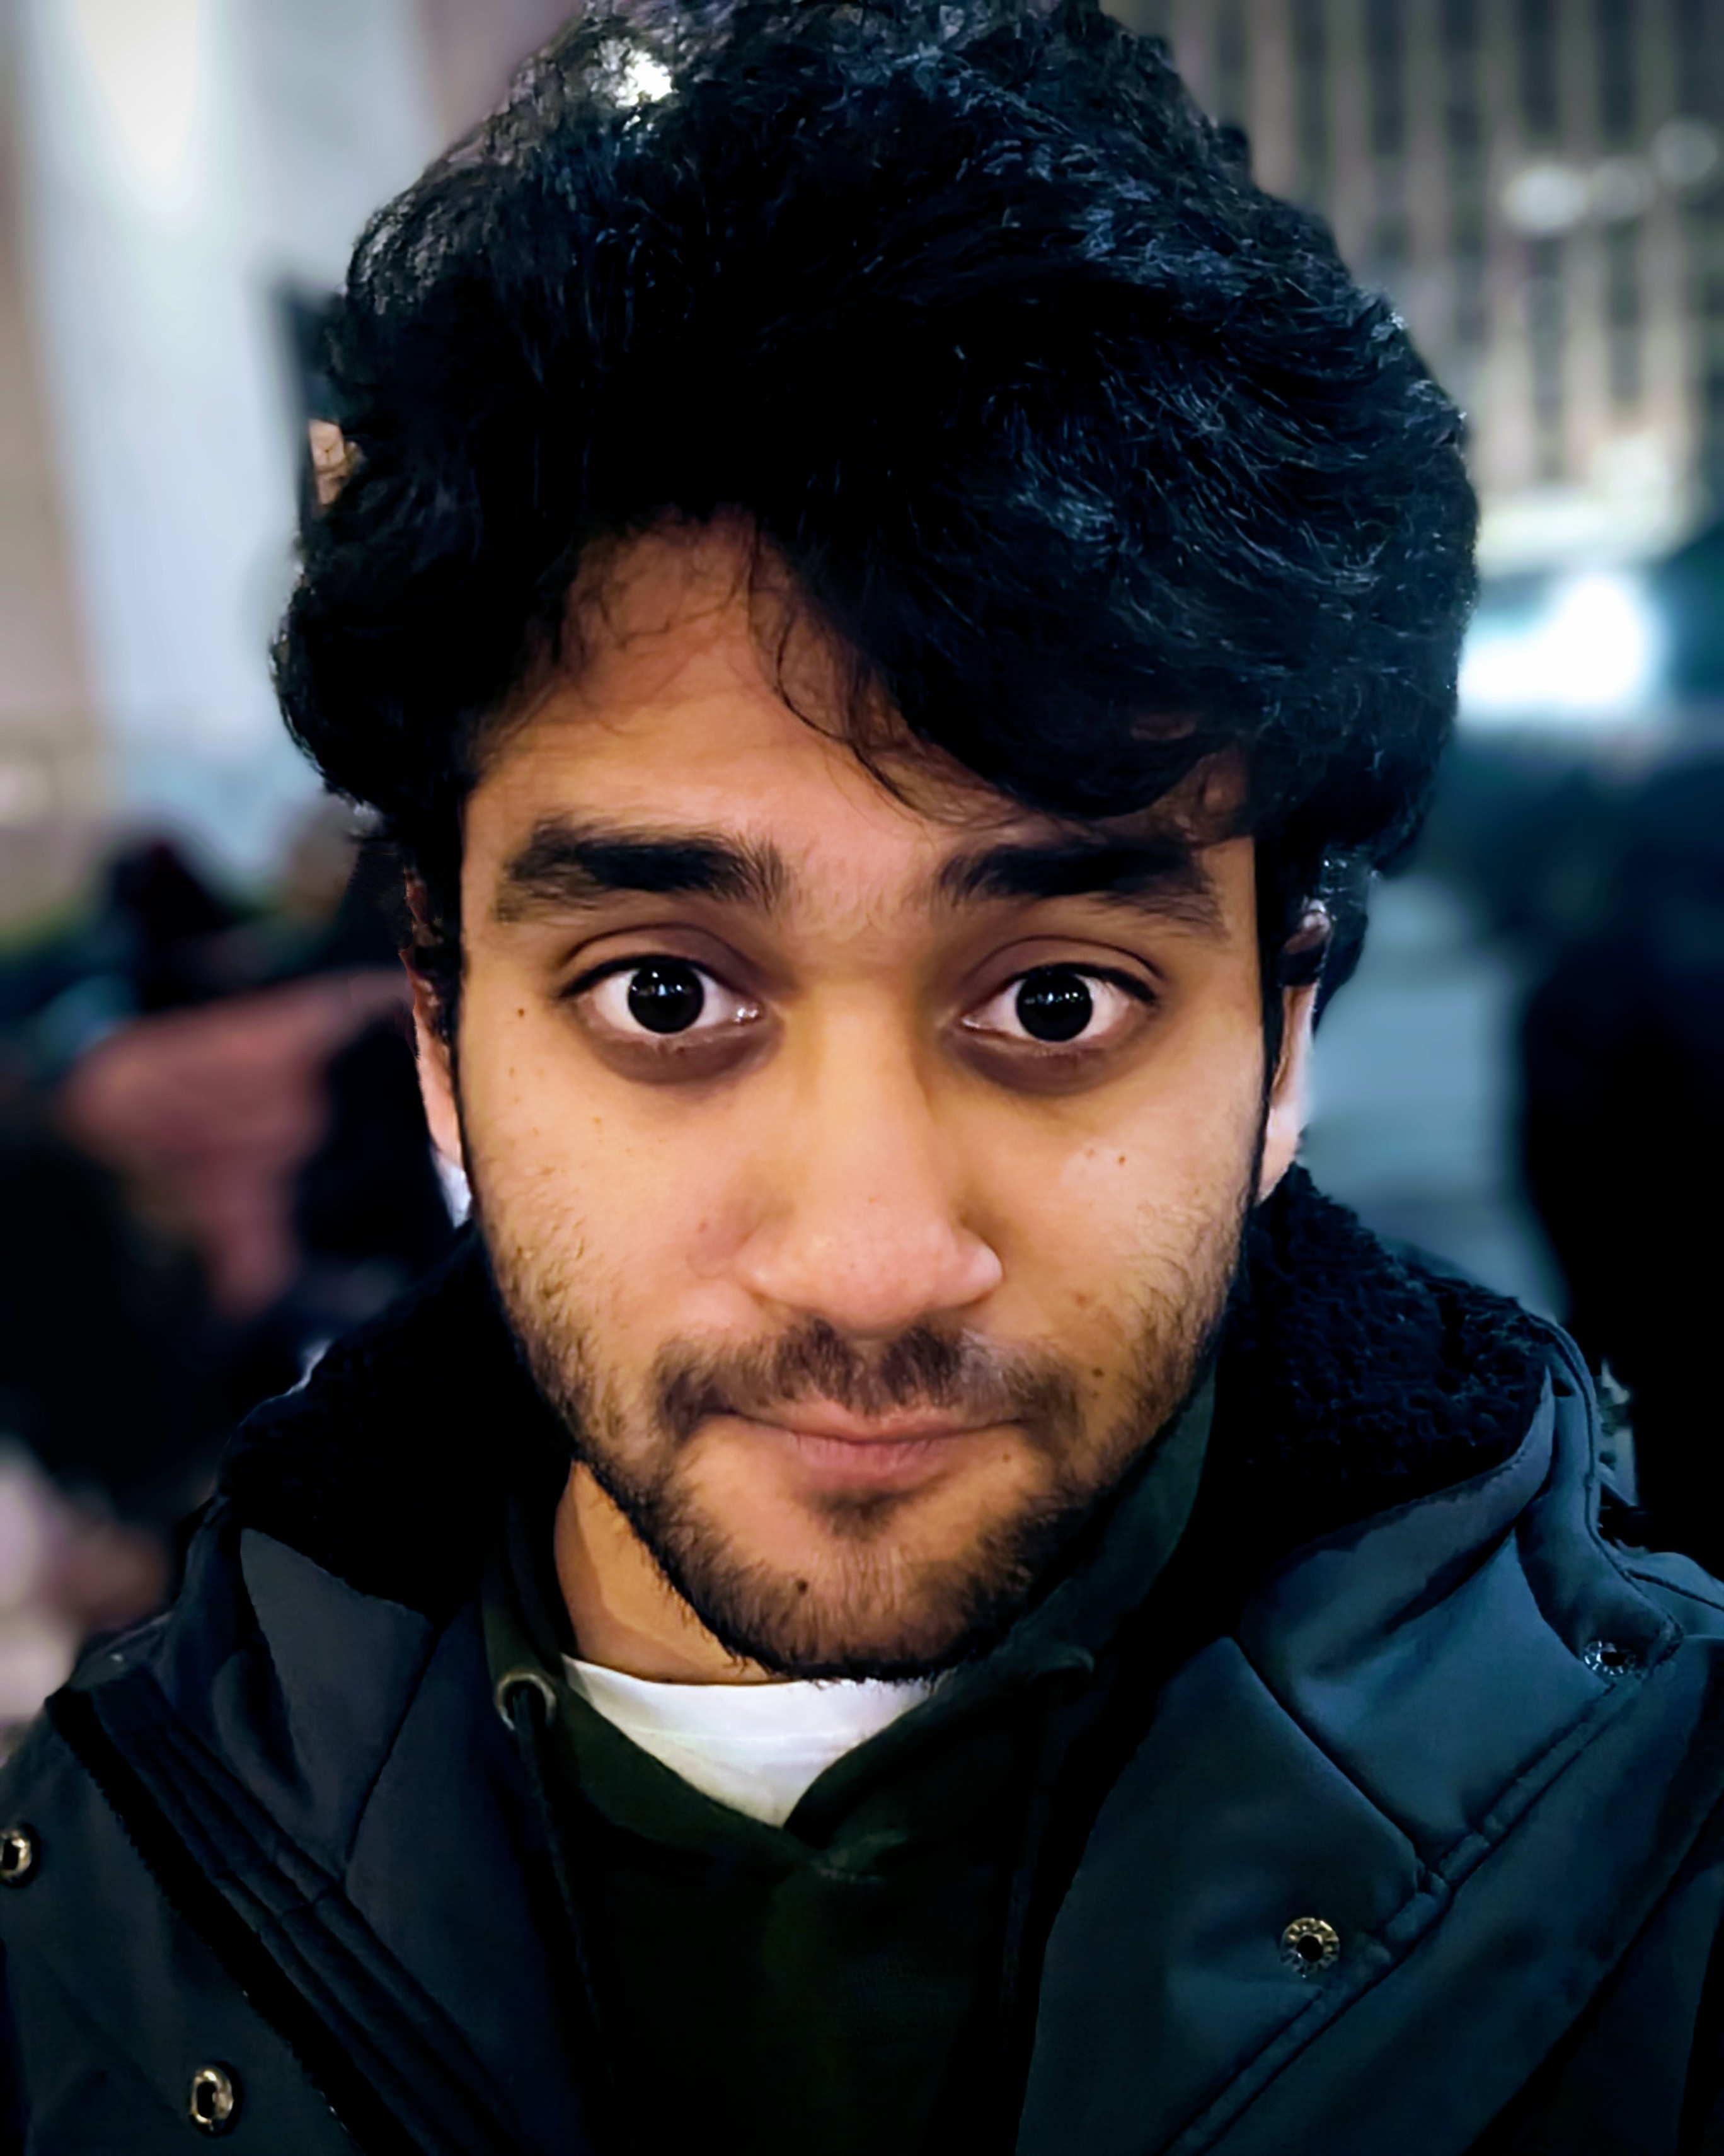
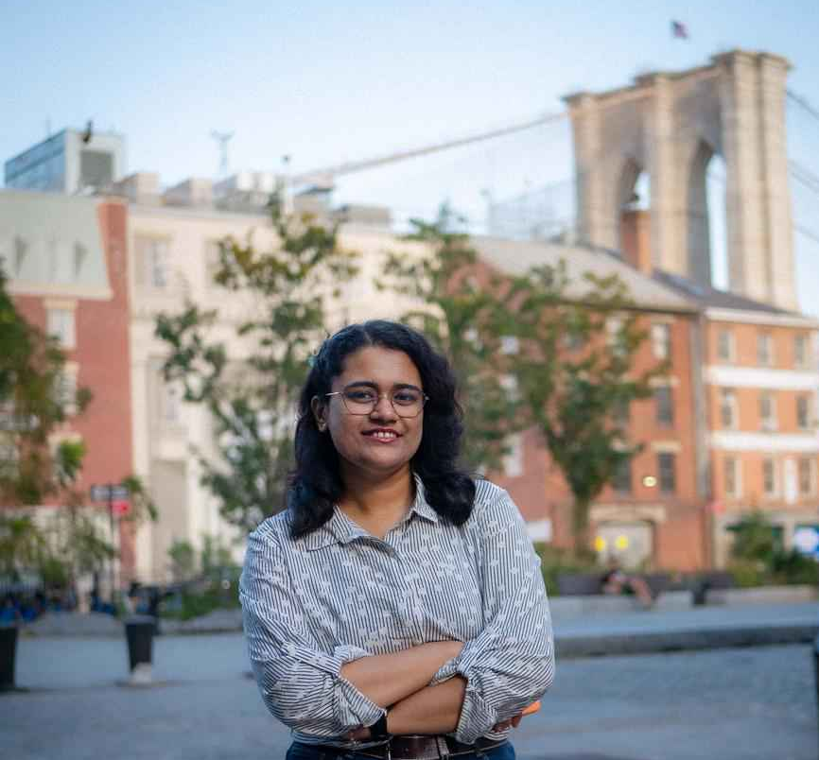

TEAM ROLE & RESPONSIBILITIES
Rakesh Tirumala
Team Lead/ Developer
Tanvi Prakash Gavali
Scrum Master/ Developer
Kaali Lovell​
Tester/ Product Designer

Slide 4
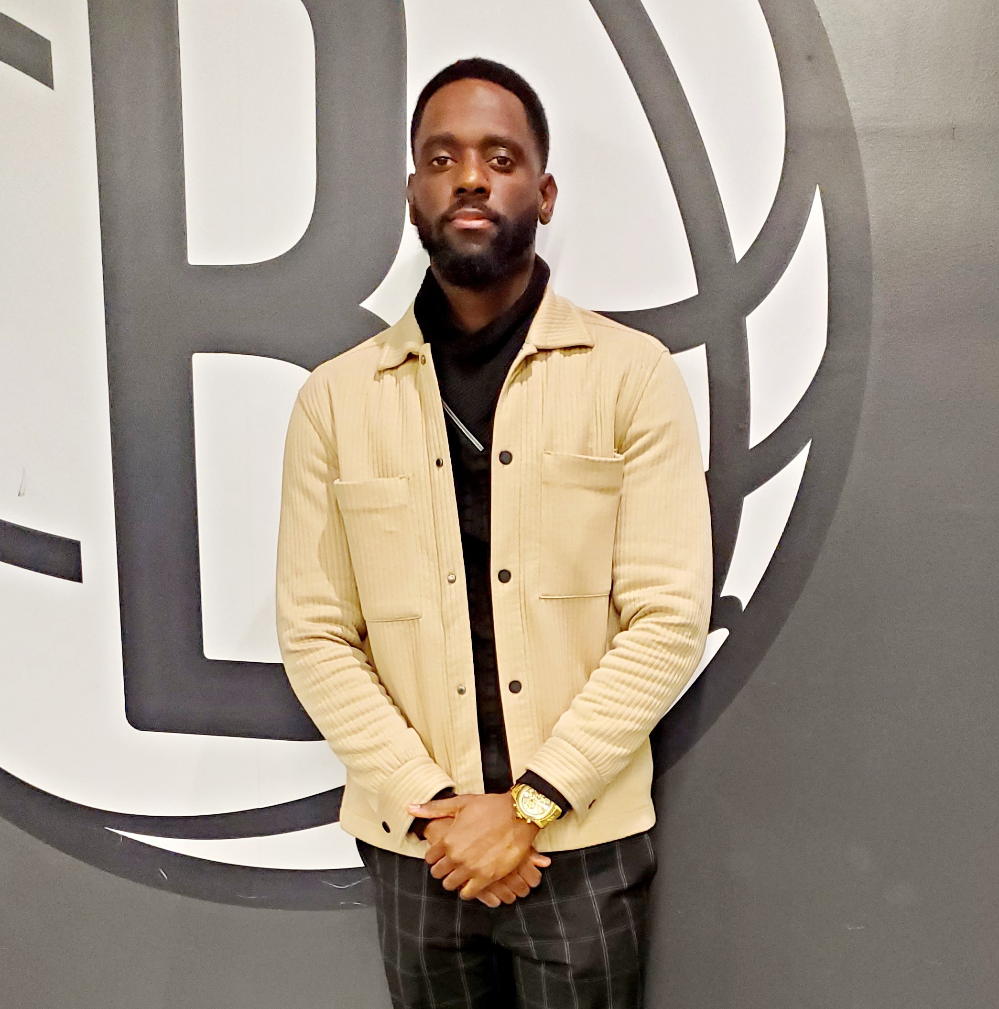
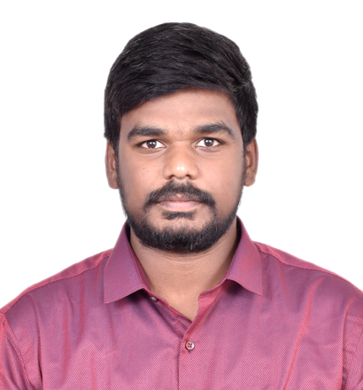
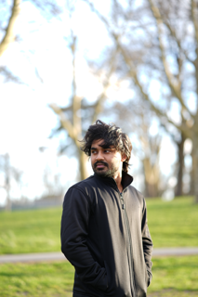
TEAM ROLE & RESPONSIBILITIES
Steve St Fleur
Developer
Venkat Sai Pallapu​
Developer
Pavan Polireddy
Developer​

Slide 5
Improvements
Team Roles and Responsibilities:
updated the Developers' roles.
Project Description:
the project description chart was added.
Team Working Agreement:
expanded on the DoD (Release DoD, MVP DoD).
Sprint Schedule:
add small milestones for the project to the deadline dates.
Technologies:
specified the names under the technologies we plan to use.
WikiPage:
added email link for team members.
added mp4 download of recording to the WikiPage.
added the files to the repository and then link to the WikiPage.

Slide 6


PROBLEM STATEMENT
Understanding foreign languages is often a challenge, as each language has its own unique structure, nuances, and meanings. Effective communication with native speakers becomes difficult without proper understanding, yet mastering every language is nearly impossible. To address this issue, we aim to create an application that helps bridge the communication gap by converting audio into transcriptions in multiple languages, enabling people to understand and engage in conversations more easily.

Slide 7
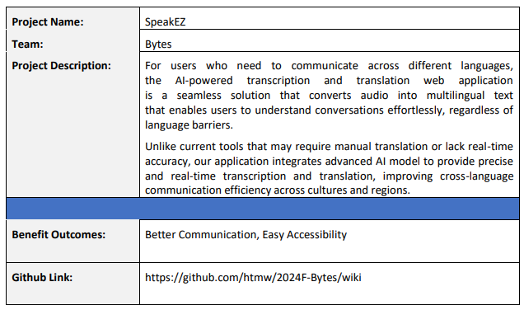

PROJECT DESCRIPTION

Slide 8
TEAM WORKING AGREEMENT
Communication:
The team will communicate with each other through Zoom and WhatsApp.
Google Docs will be utilized for collaborative document editing, sharing resources, and taking notes during team discussions.
Team members should alert the team in advance if they are unable to join a Zoom meeting.
Team members are expected to provide regular updates on task progress and promptly communicate any obstacles or delays to the group.
Team members are encouraged to actively participate in discussions, providing feedback and support as needed.
During all discussions, team members should listen carefully, speak clearly, and stay on topic to avoid confusion
Each team member should complete all assigned work before the deadline. If they are struggling with a task, they should contact the team as soon as possible to resolve the issue. Failure to complete work before the deadline can negatively affect the team’s project timeline.

Slide 9
TEAM WORKING AGREEMENT
Work Division & Participation:
Jira, and GitHub will be used to track and divide all tasks.
The entire project should be divided into equal parts, and all team members should be given equal responsibility.
If a team member is not participating to the level the other members are, the team leader is permitted to assign necessary tasks to that member.
Each team member is responsible for their assigned tasks and their contribution to the overall success of the project.

Slide 10
TEAM WORKING AGREEMENT
Meetings:
Regular team meetings will be scheduled twice a week on Sundays at 2:00 pm and Thursdays at 5:30 pm via zoom to review individual and collective progress. Failing to join these meetings will negatively affect the group.
If unable to attend a scheduled meeting, team members should inform the group in advance.
In urgent situations, additional meetings may be arranged with at least 24 hours’ notice.
Meeting agendas will be sent at least 24 hours prior to the meeting.
Meetings will commence and conclude on time, with members expected to join 2 minutes prior to the start.
All team members are required to have their Zoom cameras open during the meetings. They are required to show respect, actively listen, and participate by sharing feedback or suggestions.
Team agrees to follow these agile practices throughout the project:
Meet at the beginning of each sprint to discuss tasks for the upcoming sprint.
Meet at the end of each sprint to present the completed work and gather feedback.

Slide 11
TEAM WORKING AGREEMENT
Respect and Professionalism:
All communication and interaction within the team will be conducted with respect; diverse viewpoints and inputs should be appreciated.
Feedback should be constructive and centered on the project and not on personal traits.
If a member disagrees with a decision, they can request a review at the next team meeting.
The team aims to create a welcoming space where everyone feels comfortable sharing their ideas
Any disagreements should be addressed openly and respectfully within the team. If an internal resolution is not possible, the team will seek advice from the professor.

Slide 12
TEAM WORKING AGREEMENT
Definition of Done (Release DoD) for the Language Translator App:
The translation and transcription feature works as intended and meets all acceptance criteria and requirements.
The app successfully translates text between the specified languages without errors.
The app successfully transcribes speech to text.
Codes have been reviewed and approved by all team members.
The app has been manually tested for usability and performance.
Codes are documented with comments where necessary.
User guide and technical documentation have been updated accordingly.
The app is deployable and runs without issues.
All user stories and tasks for the current sprint have been completed.
The app contains all necessary features required for the MVP.

Slide 13
TEAM WORKING AGREEMENT
Definition of Done (MVP DoD) for the Language Translator App:
The application can transcribe the given audio into text without error.
The application can successfully translate the transcribed audio to the specified language without errors.
A user is able to upload or delete an audio file to the application without errors.
Codes have been reviewed and approved by all team members.
The app has been manually tested for usability and performance.
Codes are documented with comments where necessary.

Slide 14
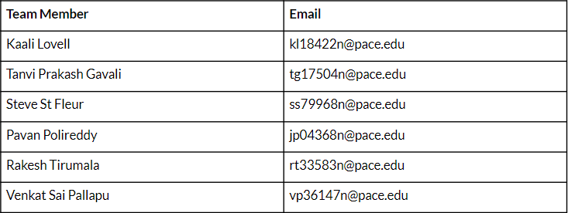
TEAM WORKING AGREEMENT

Slide 15

PERSONAS

Slide 16
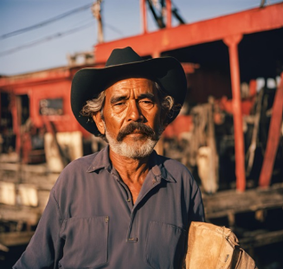
JOSÉ RODRIGUEZ, DOCKS WORKER
Demographics:
Age: 53
Gender: Male
Location: Louisiana, USA
Education: High school diploma
Experience: 15+ years
Skills and Qualifications:
Forklift License
Management in handling and securing cargo using forklifts
Excellent team worker, organized, and physically capable
Goals and Needs:
José is originally from Mexico but has relocated to USA for better working opportunities for his children. He can understand very little English as most of his coworkers speak Spanish as well. During his old age, he started having frequent visits to the doctors where they speak in English with him, which he has difficulty understanding. He does not want to burden his children with the task of translating, and wants to retain confidentiality between himself and his doctor. It is also expensive to hire professional translators - beyond his budget. Jose is looking for an application where he can converse with the doctors without any communication hindrances, and keep transcripts as part of his medical record - both before and after translation.

Slide 17
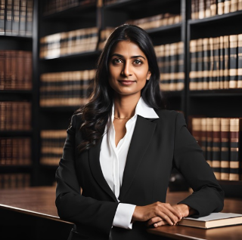
ANJALI CHITRE, LAWYER
Demographics:
Age: 27
Gender: Female
Location: Edinburgh, UK
Education: LLM in International Law
Experience: 4+ years
Skills and Qualifications:
Skilled in conducting in-depth research regarding international legal issues
Proficient in explaining legal concepts and mediating in legal cases
Professional, showcasing confidence and problem solving skills.
Goals and Needs:
Anjali’s job is to provide legal advice to multinational corporations who need to comply with different regulations for both their U.K and Swedish subsidiaries. To not disclose business information and legal strategies to a 3rd party, Anjali would like an application which can transcribe and translate discussion during meetings without breaching confidentiality or having to create further confidentiality agreements with translators.

Slide 18

NICOLE SCHULER, EXECUTIVE ADMINISTRATIVE ASSISTANT
Demographics:
Age: 27
Gender: Female
Location: Toronto, CA
Education: Bachelors of Business Administration (BBA)
Experience: 1 years
Skills and Qualifications:
Proficient in Excel, Microsoft Office, Outlook, Google Workspace
Certified Administrative Professional (CAP)
Excellent organizational, administrative, and interpersonal skills
Goals and Needs:
Nicole is originally from NYC but has relocated to Canada for work. Nicole has to attend daily meetings and transcribe the meetings for her higher-ups. Some of her co-workers switch between French and English in the meetings which frustrates Nicole since her native language is English and she has no experience with French. Nicole is looking for a tool that will help her efficiently transcribe the meetings and also assist with translating the French terms.

Slide 19
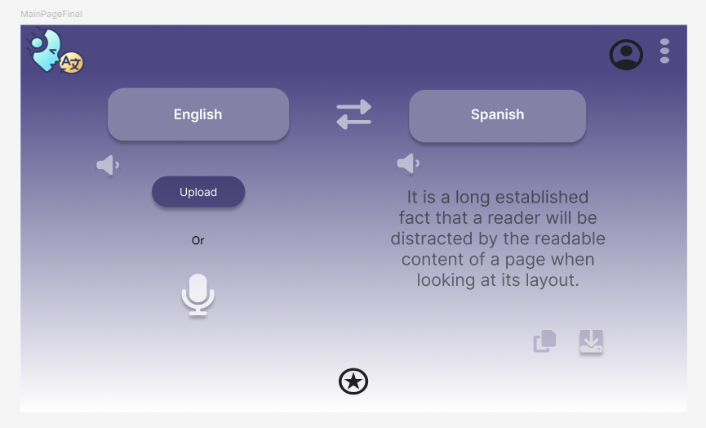
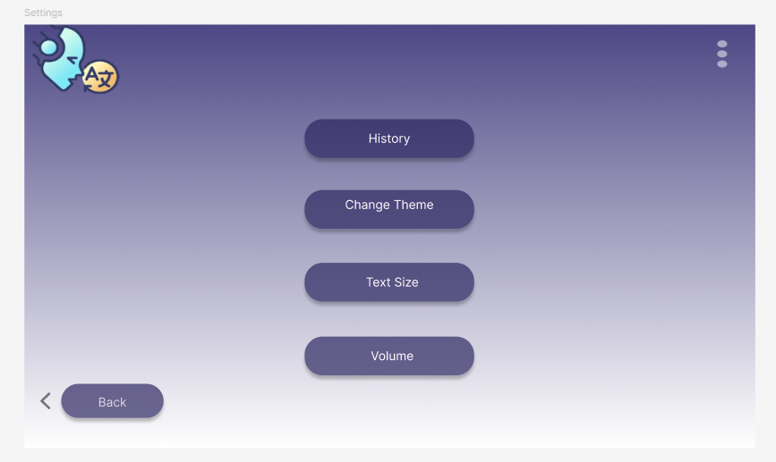
MVP Design

Slide 20













TECHNOLOGIES
Programming Languages and Frameworks | Libraries | Tools | Deployment
HTML5
CSS
Vite
HuggingFace
GitHub
VSCode
Firebase
JavaScript
React
MaterialUI
TailwindCSS
Figma
Jira

Slide 21

ALGORITHMS
The application should be able to take audio as input and convert it into the desired language. To achieve this, we need an AI model for automatic speech recognition and speech translation. So, the most suitable neural network to use in order to perform this task is a Transformer.

Slide 22
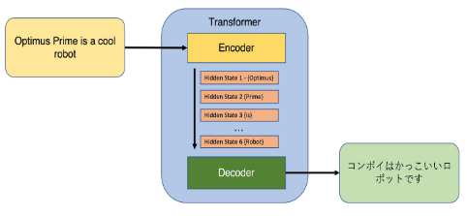
ALGORITHMS
A transformer is a neural network architecture especially designed for processing sequential data like natural language processing (NLP).
They usually use an encoder-decoder structure but make use of attention mechanism in order to capture relationships between elements in a sequence. Unlike RNNs, transformers process data in parallel which makes them faster and more scalable.

Slide 23
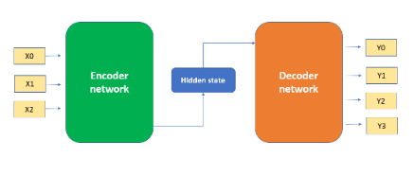
ALGORITHMS
In the encoder-decoder structure, the encoder processes the input data, which can be text, audio, etc., and generates encodings. The decoder takes these encodings, uses the derived context, and generates the output sequence.

Slide 24
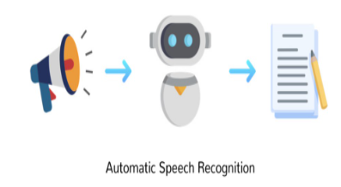
ALGORITHMS
Whisper is a transformer based on the encoder-decoder structure. It was trained on 680,000 hours of labelled speech data. The model can perform both speech recognition and speech translation.

Slide 25
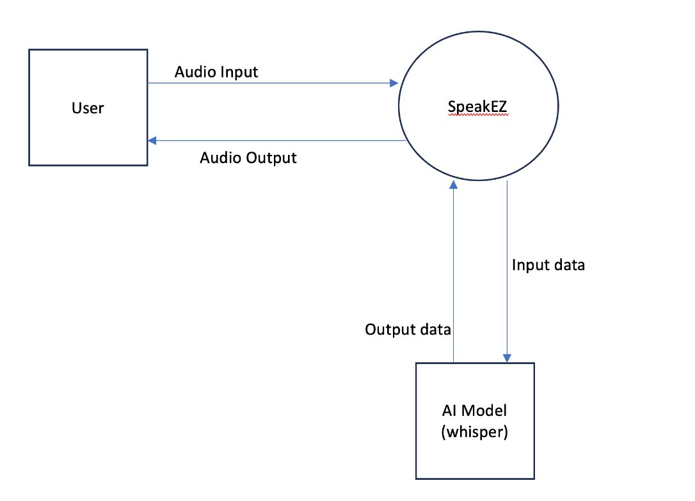
Context Diagram

Slide 26
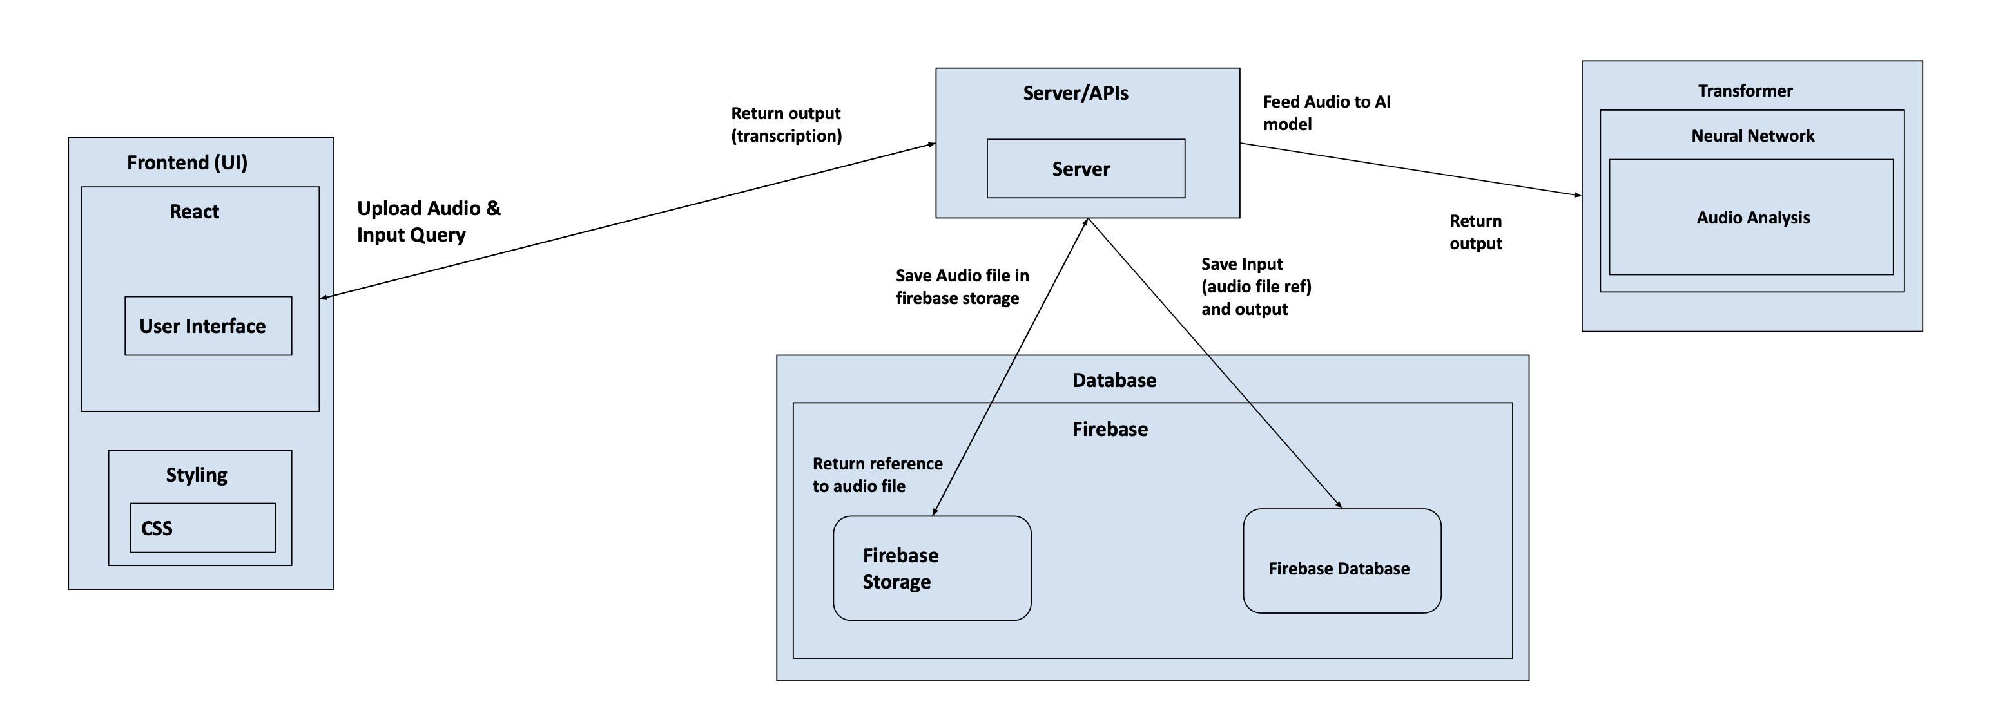
Architecture Diagram

Slide 27
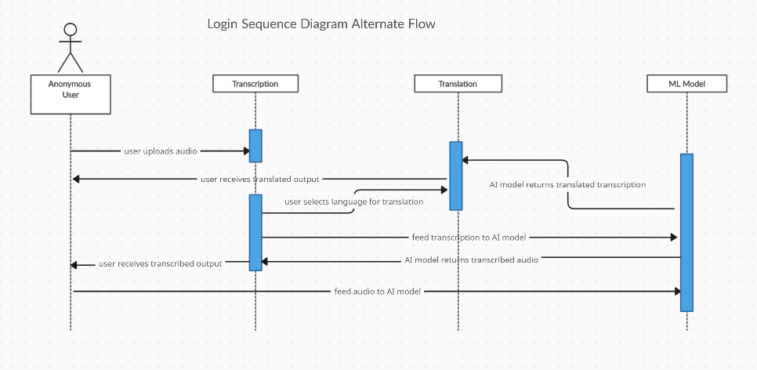
Sequence Diagram

Slide 28
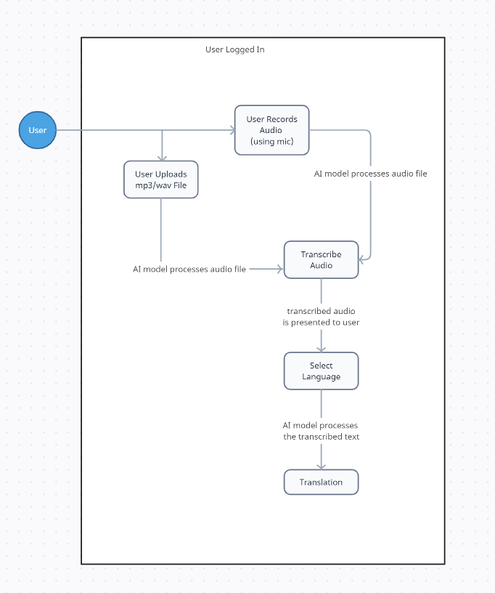
State Diagram

Slide 29
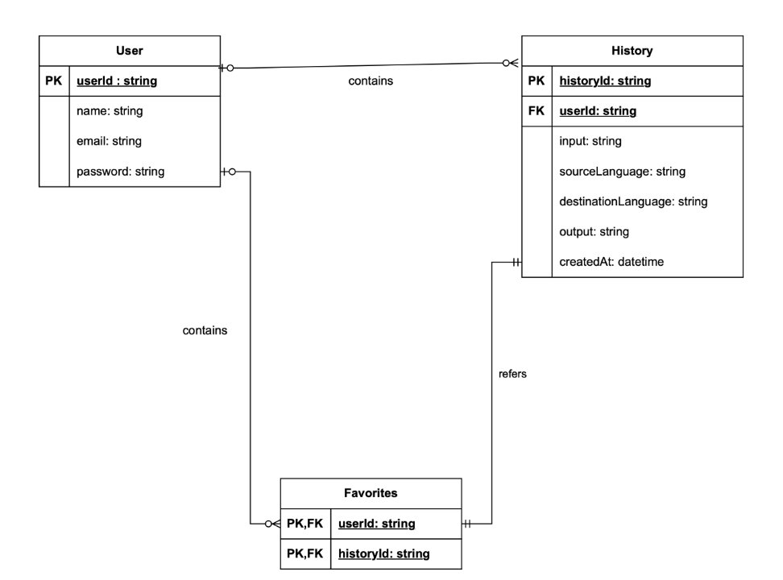
Class Diagram

Slide 30
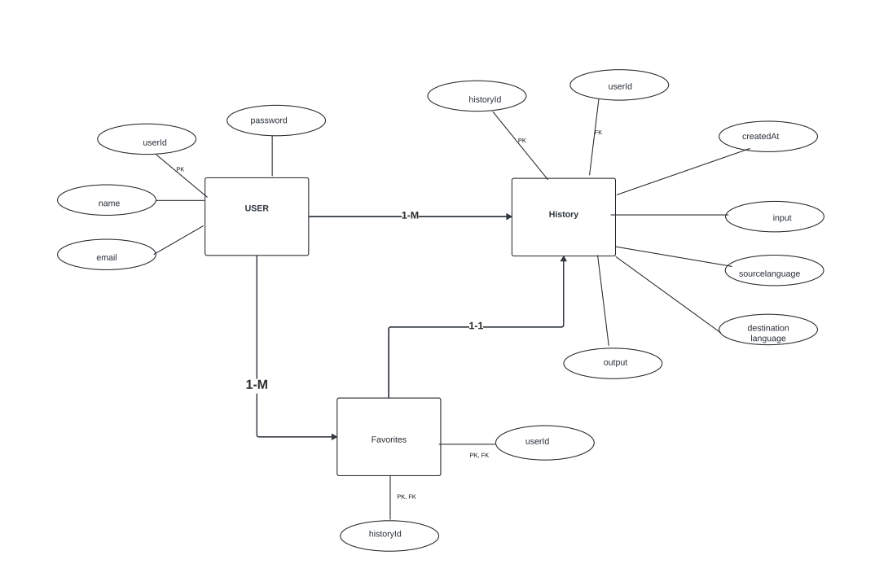
ER Diagram

Slide 31
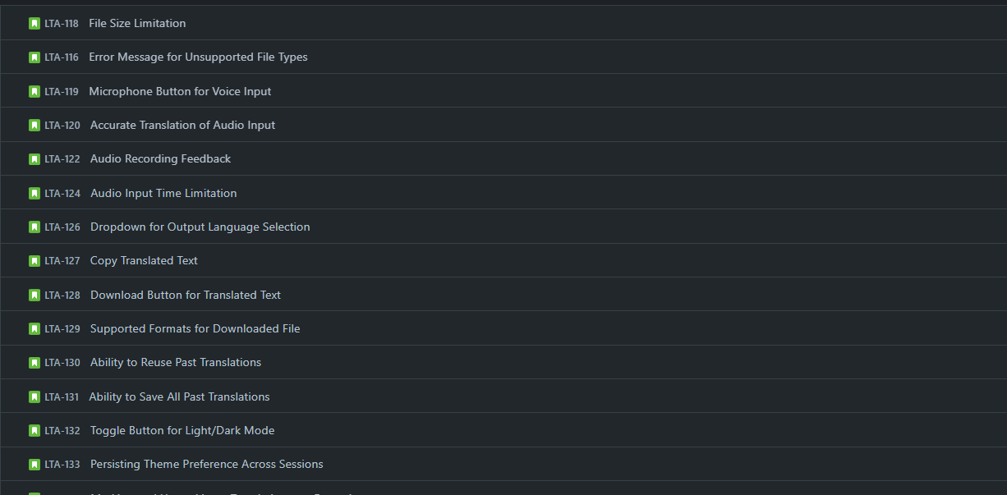
User Stories

Slide 32
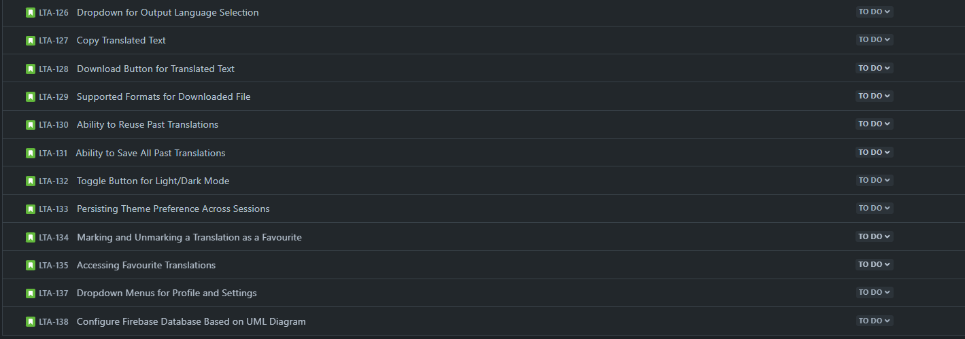
User Stories

Slide 33
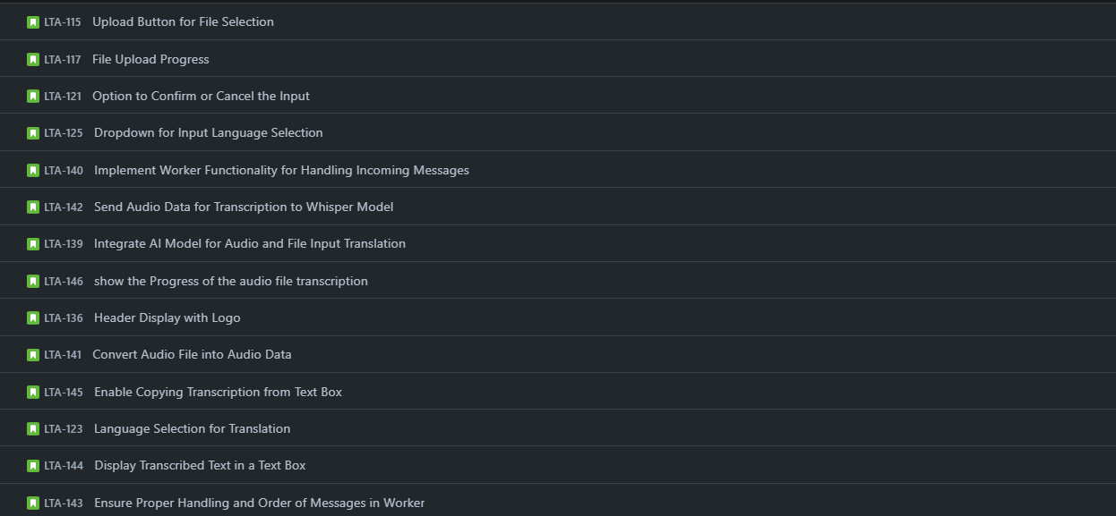
User Stories

Slide 34
Test Cases
Feature to Test | Test Case | Test Steps | Test Data | Expected Result | Actual Result | Pass/Fail
"Upload" button | Ensure chosen file is uploaded | Click upload > file explorer opens > select audio file | .mp3 .wav | Selected audio file is presented on screen | Audio file was accepted | Pass
"Upload" button | Verify accepted audio type | Click upload > file explorer opens > searches through to ensure no other file types are shown to be accepted | .mp3 .wav .m4a .wma .flac | Only .mp3 and .wav files should be shown as accepted files in file explorer | The program allows for both .mp3 and .wav files to be selected | Pass
"Upload" button | User should be able to see the file name on screen once its selected | Click upload > file explorer opens > select audio file > file name shows on screen | .mp3 .wav | The audio file name is shown on screen after being selected | The file name was shown on screen after being selected | Pass
"x" Delete Button | Once user select the "x" icon, the file is deleted, and user is unable to see the name of file on screen | Click upload > file explorer opens > select audio file > file name shows on screen > click "x" icon next to file name > file deleted | .mp3 .wav | The file should be deleted and the file name should be removed from screen | User is able to click on the "x" icon, and the file was deleted. The file name was removed from display | Pass
Transcribe Button | Transcribe button should redirect page | Click "Transcribe" button > Page redirected to the transcription-translation page | .mp3 .wav | When a user click the "Transcribe" button, it redirect you to another page that shows the transcribed texts | User was redirected to the correct transcription-translation page | Pass
Transcribe Button | Transcribe button should initiate whisper model | Click upload > file explorer opens > select audio file > click "Transcribe" > inspect the page: console | .mp3 .wav | As the transcription process is occurring, and you're inspecting the page using the console, one should see the messages "DOWNLOADING", the AI model being called, and an object returned with the transcribed text. | The expected results occurred as expected, there were also some warnings shown. | Pass
Transcribe Button | Audio transcribed correctly | Click upload > file explorer opens > select audio file > click "Transcribe" > read transcribed text displayed | .mp3 .wav | What is said in audio should be shown as text in the text-box | The audio was transcribed correctly. Even when spoken in a foreign language such as Spanish, & German, it was transcribed correctly. | Pass
Page Functionality | Transcribe text presented in correct textbox | Click upload > file explorer opens > select audio file > click "Transcribe" > view where the transcribed text is displayed | .mp3 .wav | The transcribed text is shown in the text box specified to hold the transcribed text | The transcribed text was presented in the correct text-box | Pass
Page Functionality | Ability to edit transcribed text | Click upload > file explorer opens > select audio file > click "Transcribe" > add to the transcribed text & also delete some text from the text box | .mp3 .wav | Should be able to add or delete the transcribed text in the text box | User is able to add and remove from the transcribed text | Pass

Slide 35
Sprint 1 Stories

Slide 36
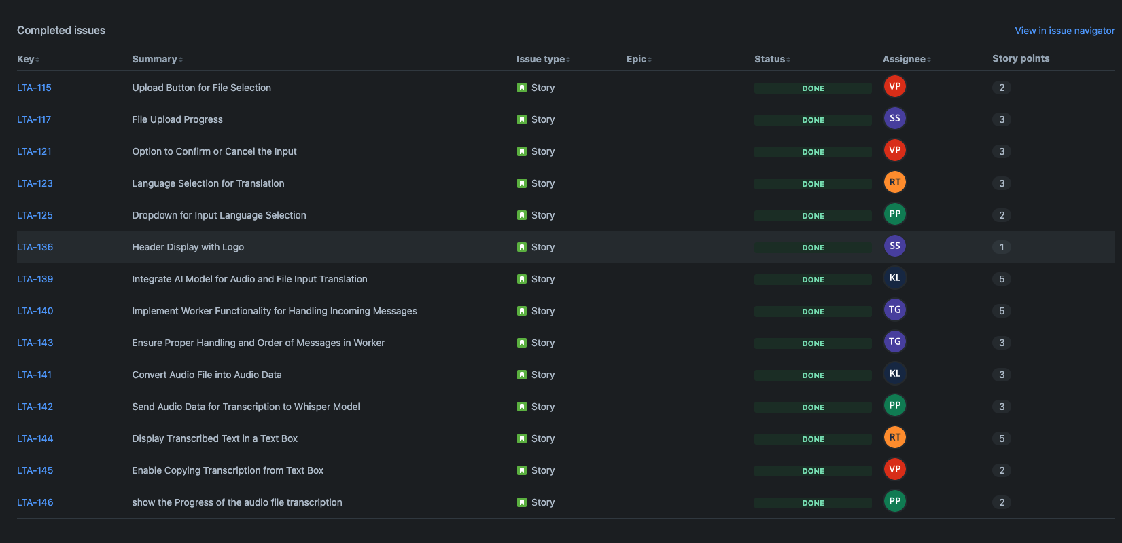
Sprint 1 Stories Completed

Slide 37
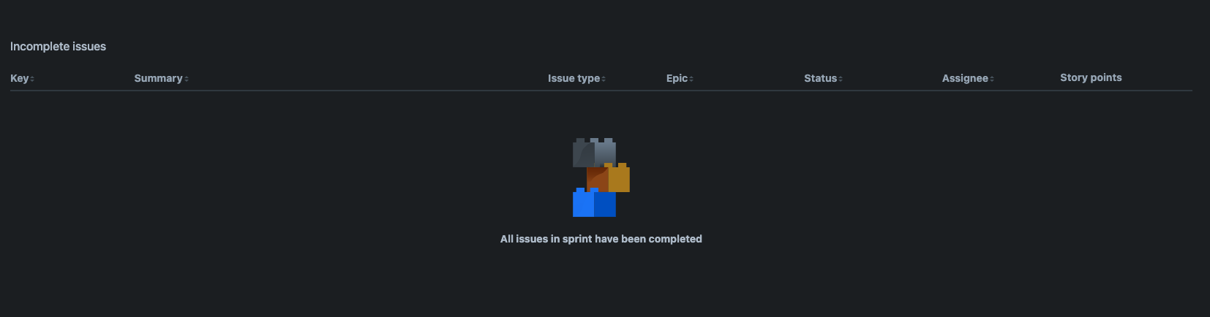
Sprint 1 Stories Not Completed

Slide 38
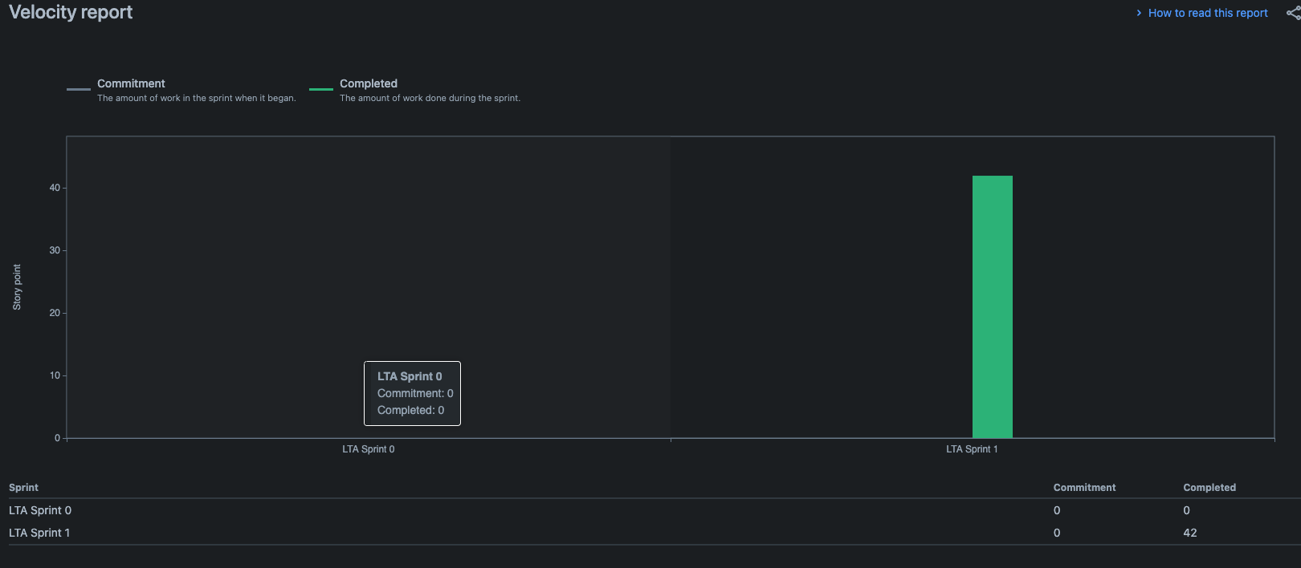
Team Velocity- Sprint 1

Slide 39
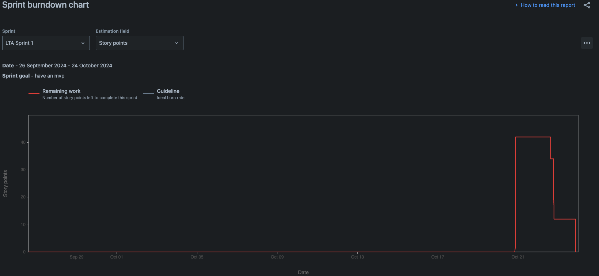
Burndown Chart

Slide 40
Completed / Committed Ratio
42 / 42

Slide 41
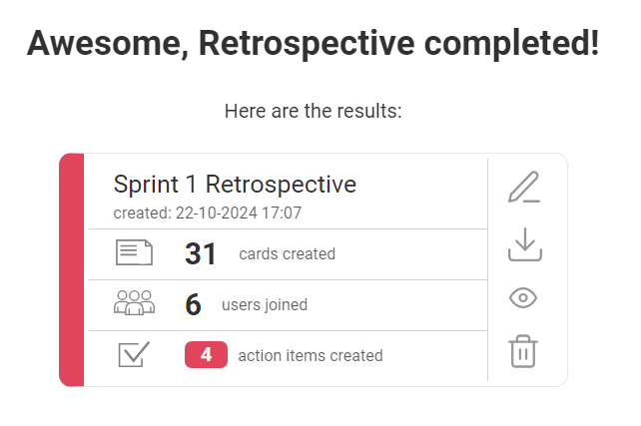
RETROSPECTIVE

Slide 42
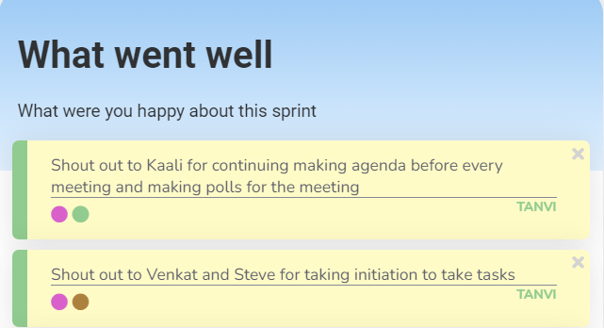
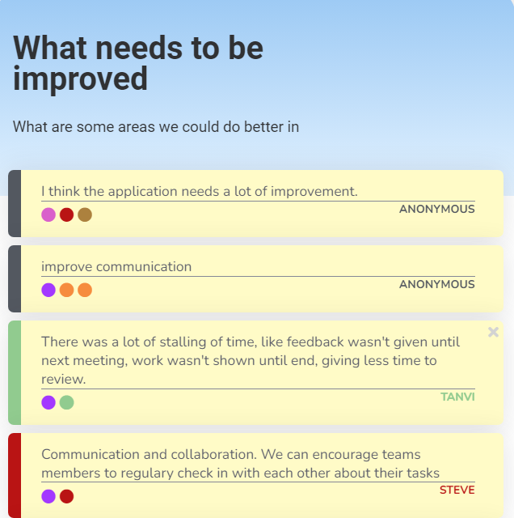
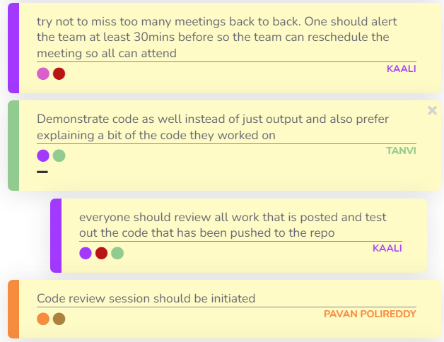
RETROSPECTIVE

Slide 43
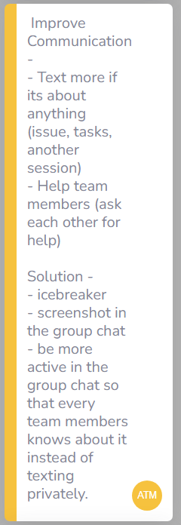
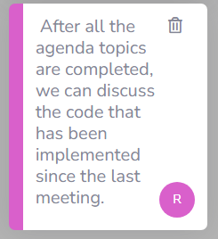
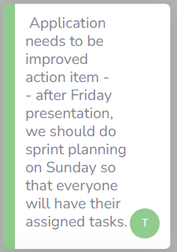
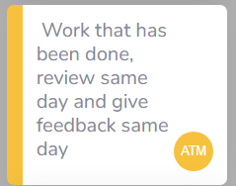
RETROSPECTIVE – Action Item
https://youtu.be/RANnmD3Wrd8

Slide 44
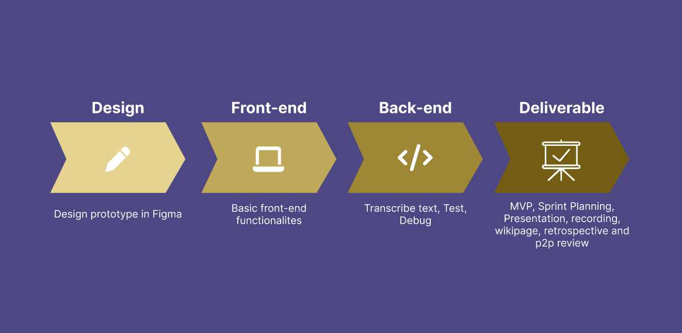
Timeline

Slide 45
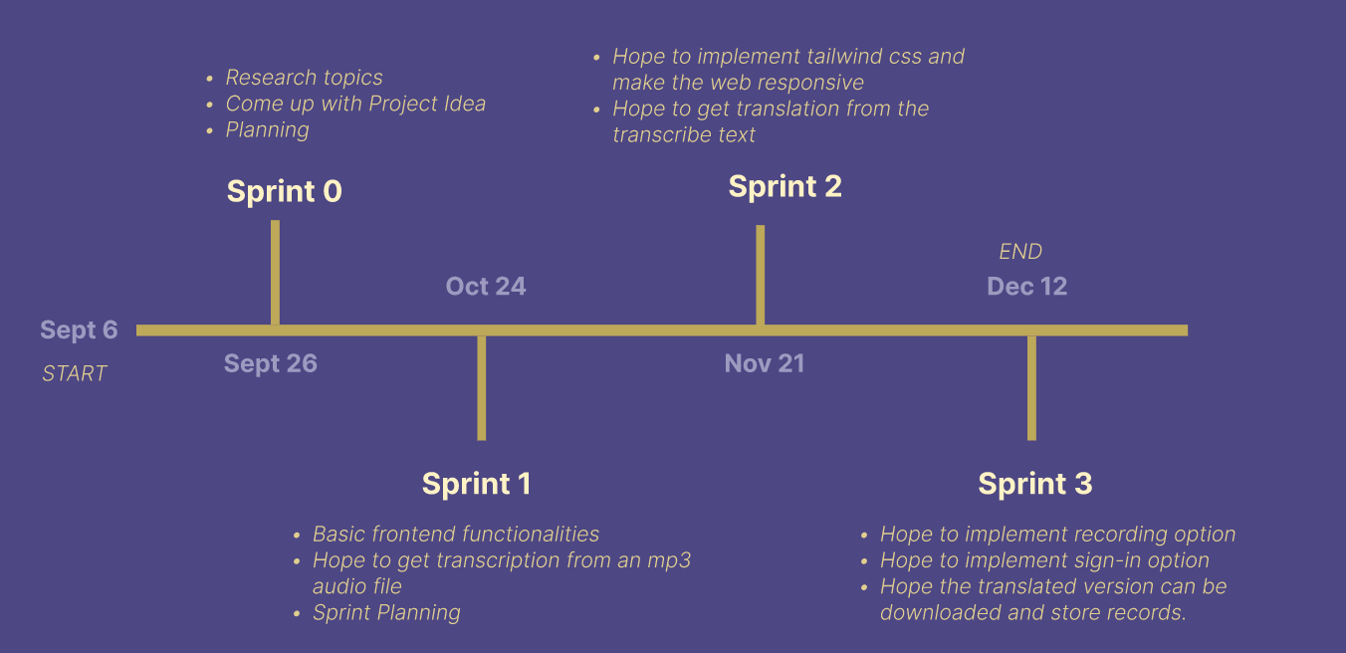
PROJECT SCHEDULE

Slide 46
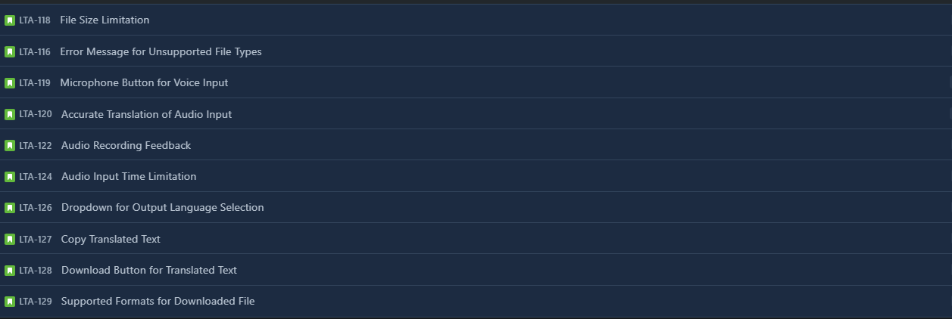
Sprint 2 Stories

Slide 47
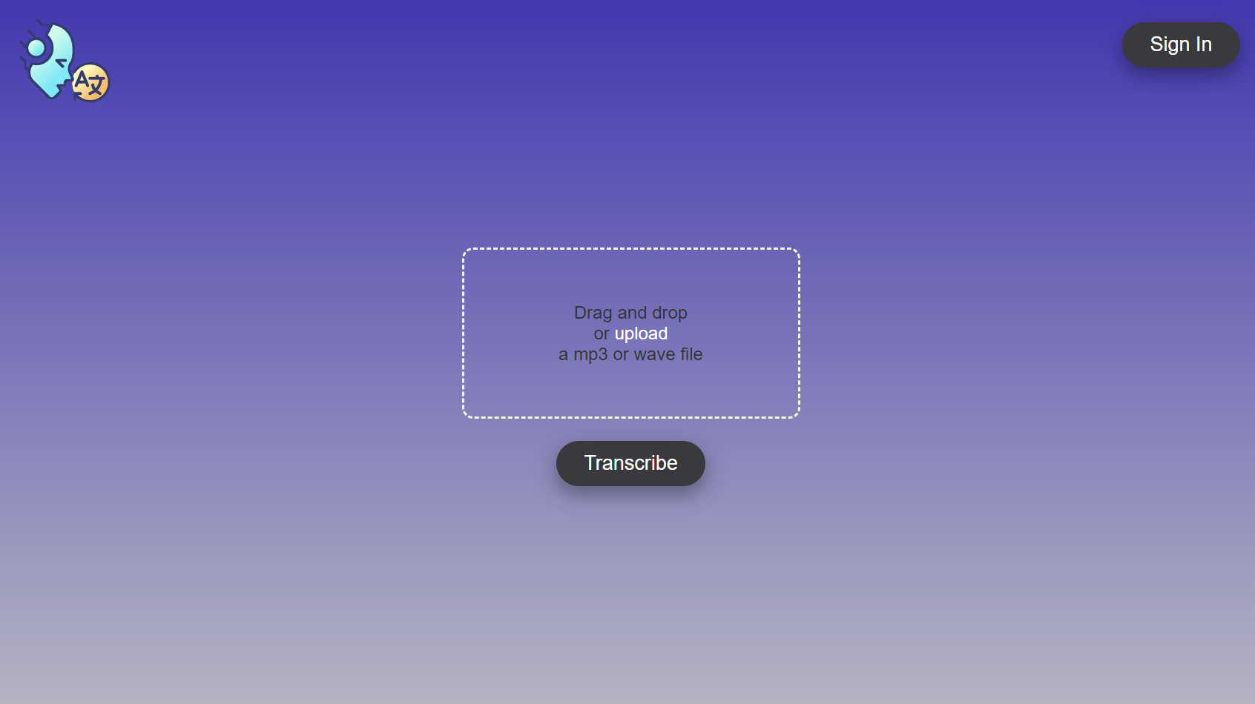
SpeakEZ Screenshot

Slide 48
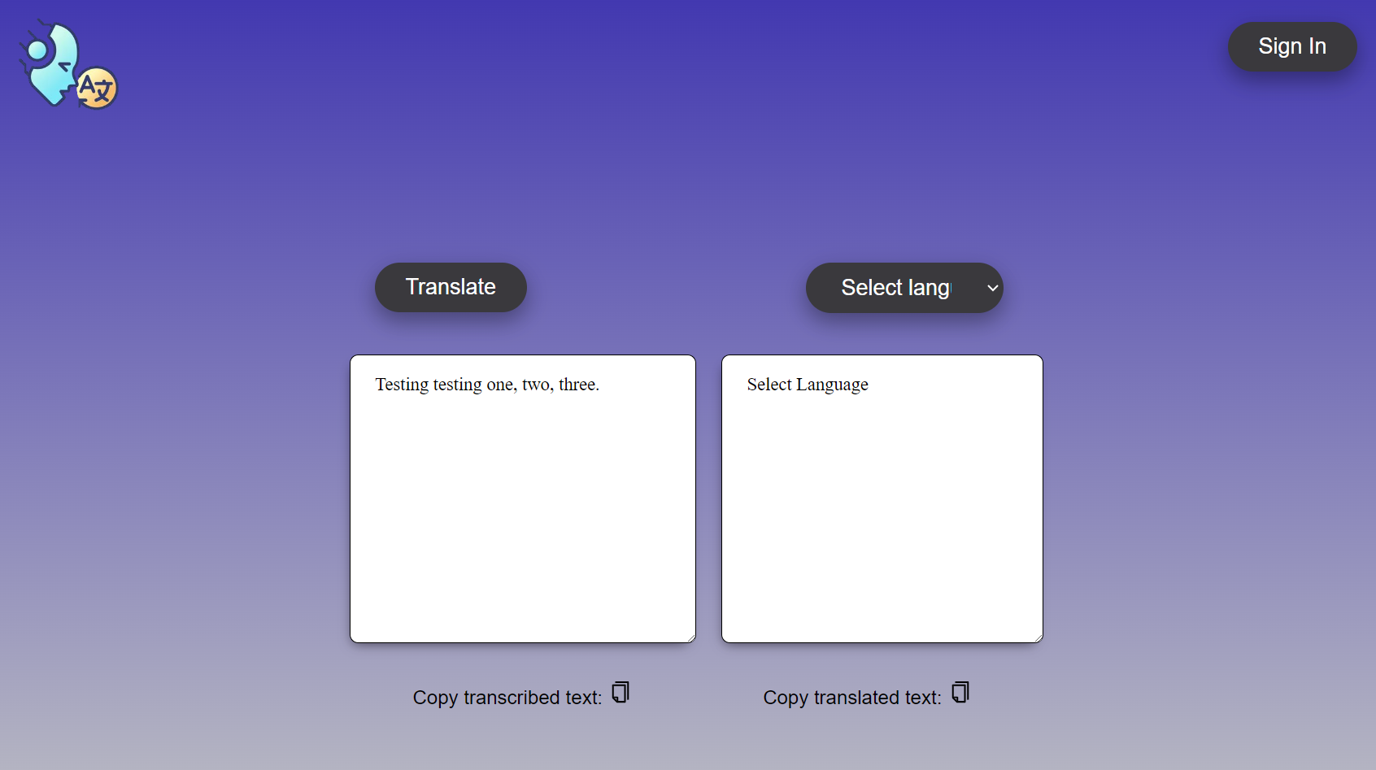
SpeakEZ Screenshot

Slide 49
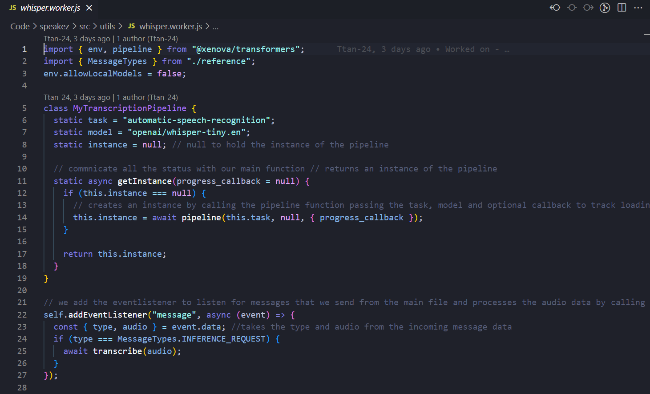
SpeakEZ Pipeline

Slide 50
SpeakEZ Demo

Slide 51
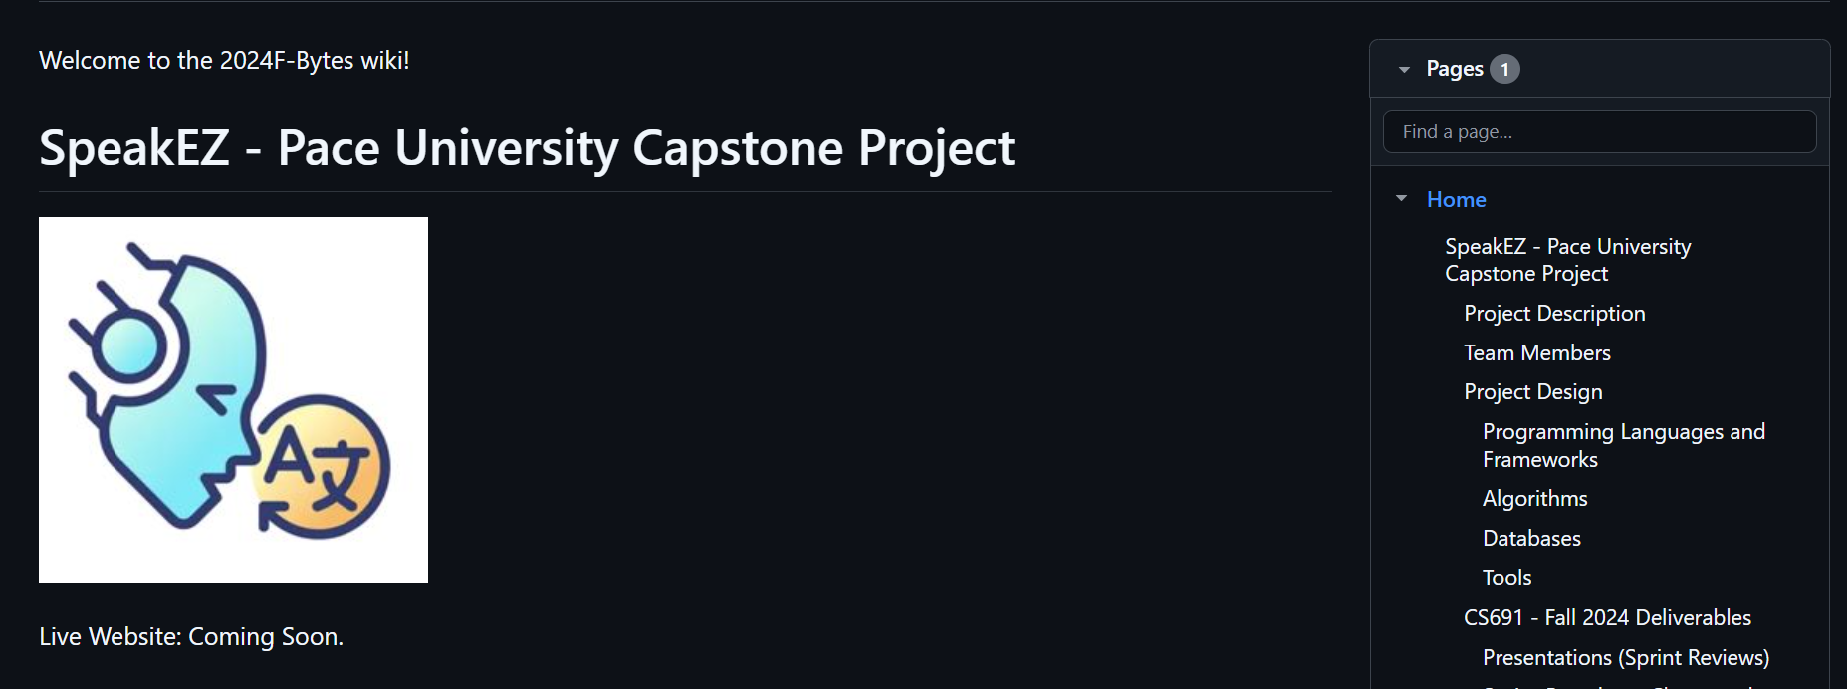
WIKIPAGE LINK
https://github.com/htmw/2024F-Bytes/wiki

Slide 52

THANK YOU!
Do you have any questions?

